Slide 1
City Council Budget Workshop
August 11, 2025

Slide 2








KEY BUDGET DRIVERS – FY2026
Economic State & Inflation
Personnel Costs
Debt Service Obligations
Proactive Maintenance
Operational Costs
Vehicle Replacement Costs
Capital Projects/Infrastructure Improvements Funding
Tax Rate
Notes:
In a nutshell, like every other business or organization, the City is experiencing expenditure growth with revenues struggling to keep pace.
Deferred infrastructure maintenance and equipment purchases are resulting in higher costs for repairs and replacements. And, personnel costs increase annually for the City to recruit and retain its most valuable asset, our employees.
Please keep these factors in mind as we move through tonight’s presentation of the proposed budget and what we, City staff, believe is needed to maintain and/or enhance the service levels our citizens expect of their award-winning community.

Slide 3
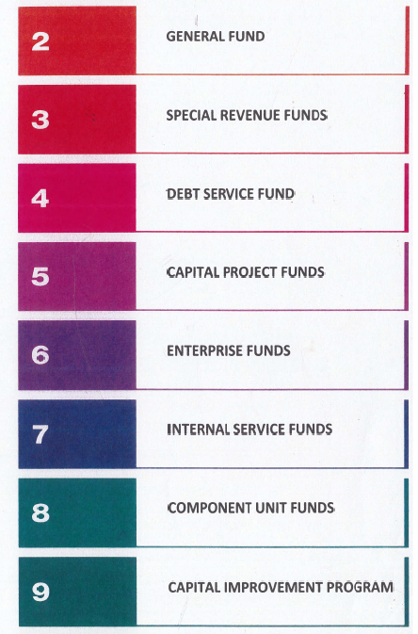
Fund Categories

Slide 4
Accounts for all revenues and expenditures applicable to the general operations of City government except for those required to be accounted for in another fund. General Fund revenues are derived primarily from sales tax, property taxes, franchise taxes, fines and fees and intergovernmental revenues.
General Fund

Slide 5
Based on last week’s discussion regarding the tax rate and at the direction of the majority of city council, the following changes have been made:
General Fund Changes
Changes
Reduced proposed property tax rate from $0.33 to $0.30
Reduced property tax revenues by $1,476,950
Shifted the reduction in revenues to the use of fund balance by $1,476,950

Slide 6
General Fund Revenues

Slide 7

















FY2026 GENERAL FUND REVENUE ~ $42.2M
Page 2-7
Sales Tax
Property Tax
Franchise Tax & Mixed Beverage Tax
Interfund
Transfers
Fines
$21.25M
$10.3M
$2.3M
$1M
$3.9M
Decreased by $1.476M to $8.9M
Licenses & Permits
Intergovernmental
Charges for Services
Investment Interest & Miscellaneous
Use of
Fund Balance
$1.25M
$795K
$1.6M
$1.14M
$0.00
Balanced Budget
$1.476M
Notes:
Sales tax and property tax collections have an inverse relationship due to the $0.005 allocated to reducing property taxes

Slide 8
General Fund Revenues

Slide 9
General Fund Sales Tax Revenues
Notes:
In FY2023, approximately $8.1 million of sales tax was generated from the ½ cent sales tax reduction to property taxes.
This equates to approximately a 21.8 cent reduction in the property tax rate for FY2024.

Slide 10
Property Tax Revenues
Fiscal Year | Property Tax Revenues | Certified Taxable Value | Value of New Development | Tax Rate
2020 | $11,151,561 | $2,671,027,466 | $52,581,843 | $0.415
2021 | $11,584,034 | $2,896,008,749 | $103,023,518 | $0.400
2022 | $12,238,277 | $3,220,599,267 | $62,801,377 | $0.380
2023 | $13,361,451 | $3,712,499,542 | $172,653,147 | $0.355
2024 | $14,768,790 | $4,100,344,059 | $211,101,572 | $0.342
2025 | $14,798,974 | $4,542,292,314 | $129,390,395 | $0.320
2026 Proposed | $16,176,120 | $4,820,640,923 | $102,400,721 | $0.330
2026 Revised | $14,699,170 | $4,820,640,923 | $102,400,721 | $0.300
Notes:
$387k increase from 2023 to 2024 10% increase

Slide 11
General Fund Expenditures

Slide 12




FY2026 GENERAL FUND EXPENDITURES $43.7M
Page 2-11
$33.6M
$2.3M
$6.6M
$1.2M
$31k
Personnel Services
Supplies
Maintenance & Services
Transfer to Other Funds
Other Expenses
Notes:
Public Safety increase is $1.2M

Slide 13
General Fund Expenditures by Division

Slide 14
General Fund Expenditures by Function

Slide 15
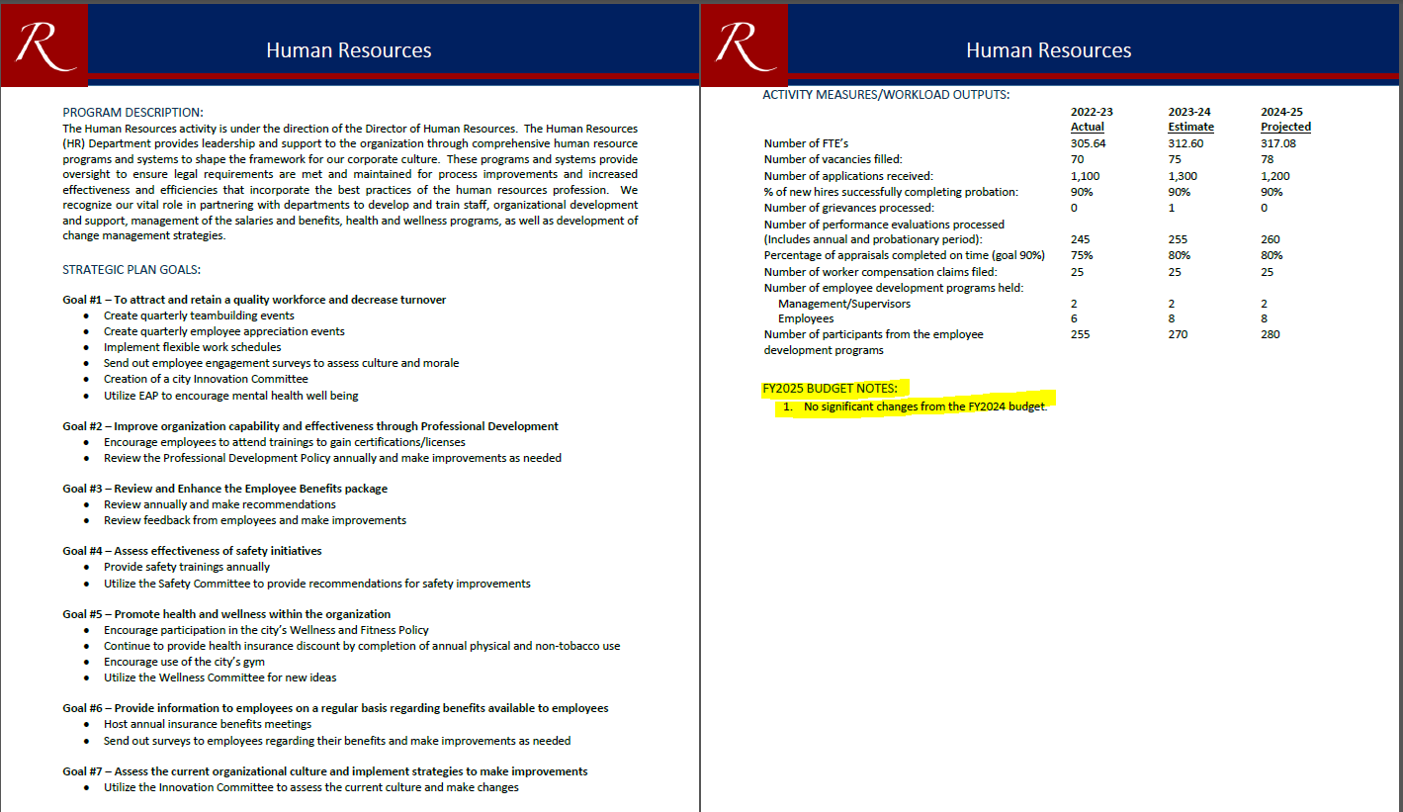
Each department will have a cover sheet outlining a brief description of the department along with the department’s goals, activity measures and outputs
Budget Notes are also included to highlight any major changes

Slide 16
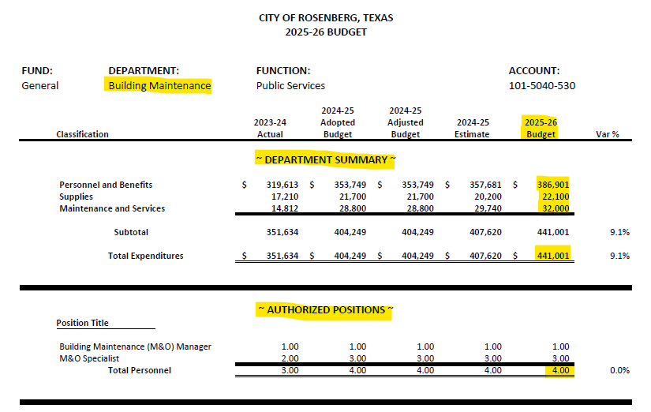
After each coversheet, a departmental summary broken down in rows by Personnel & Benefits, Supplies and Maintenance & Services. Below the summary will be a listing of the authorized positions within that department.
Detailed expenditure line items to follow.

Slide 17
General Fund Divisions
General Government
Mayor & Council
Public Safety
Police Department
Public Services
Engineering
Community Development
City Manager
City Secretary
Finance
Municipal Court
City Attorney
Human Resources
Planning
Code Compliance
Fire Department
Emergency Management
Fire Marshal
Animal Control
Public Works
Street Lighting & Signals
Fleet Maintenance
City Prosecutor
Technology
Communications
Economic Development
Parks & Recreation
Health
Building Maintenance

Slide 18
Personnel/Operating Costs
Non-Step Pay Plan Employees will receive salary wage increases ranging from 5% to 8%
Step Pay Plan employees will receive their 2.5% step increase in addition to the 10%/8%/5% increase received on June 1, 2025
20.7% increase in health insurance premiums and shift in employer contribution for dependent coverage from 50% to 55%
Addition of 4 Full Time positions
Infrastructure Plans Examiner – Engineering (General Fund)
Building Inspector – Code Compliance (General Fund)
EMS Captain – Fire (General Fund)
M&O Technician – Water Distribution (Water/Wastewater Fund)
Reclass Fire Marshal from part-time to full-time as well as other reclasses

Slide 19
General Fund Changes
Maintenance & Services:
Increase of $25,000 to Election Services in City Secretary for May 2026 election(s) (2-38)
Increase of $33,837 to Appraisal District Services, as assessed by the CAD, in Finance department due to growth in City (2-43)
Increase of approximately $55,400 to technology costs and additional software for general fund departments (2-66)
Increase to several departments’ Fleet Replacement line items to account for cost increases to replace vehicles (2-89) (2-99)
Reduced Infrastructure Inspection Fees due to change in accounting for collecting fees and deposits (2-111)

Slide 20
General Fund – General Government
Departments
City Manager (2-24)
Human Resources (2-27)
Economic Development (2-31)
City Secretary (2-35)
Finance (2-39)
Court (2-44)
City Attorney (2-50)
City Prosecutor (2-52)
Technology (2-54)
Communications (2-58)
General Government (2-64)

Slide 21
General Fund – Community Development
Departments
Planning (2-70)
Code Compliance (2-75)
Health (2-79)

Slide 22
General Fund – Public Safety
Departments
Police (2-84)
Animal Control & Shelter (2-90)
Fire (2-94)
Emergency Management (2-100)
Fire Marshal (2-103)

Slide 23
General Fund – Public Services
Departments
City Engineer (2-108)
Public Works (2-112)
Street Lights/Signals (2-118)
Fleet Maintenance (2-120)
Parks Maintenance (2-124)
Building Maintenance (2-129)

Slide 24
Special Revenue Funds
Are used to account for and report the proceeds of specific revenue sources that are restricted or committed to expenditures for specific purposes other than debt service or capital projects.

Slide 25
Special Revenue Funds
212 Hotel/Motel Fund (Kveton) 3-2
213 Municipal Court Technology Fund (Garza) 3-10
214 Beautification Fund (Vasut) 3-13
215 Law Enforcement Fund (White) 3-16
216 Community Dev. Block Grant Fund (Vasut) 3-19
218 Police Asset Forfeiture Fund (White) 3-22
220 Animal Control Donation Fund (Polio) 3-25
221 Park Land Dedication Fund (Lamensky) 3-28
222 Juvenile Case Manager (Garza) 3-31
223 Child Safety Fund (Garza) 3-34
224 Building Security Fund (Garza) 3-37
226 MUD Fire Services Fund (Vasut) 3-40
227 Police Federal Forfeiture Fund (White) 3-43
228 PEG Capital Fund (Vasut) 3-46
230 Fire Station No. 3 Operating Fund (Maretka) 3-49

Slide 26
Hotel/Motel Fund (Fund 212) Changes (3-7)
Maintenance & Services:
Decrease to Contribution to Other Entities (Grant Program) from $100,000 to $50,000 due to yearly decreases in fund balance over the last several years
Program amount being reduced or can be removed if City Council chooses
Funding in this fund is needed to cover a big portion of the operations at our Civic Center

Slide 27
Law Enforcement Fund 215 Changes (3-16)
Capital Outlay:
Machinery & Equipment of $366,000 includes (Year 1 of 5-year agreement):
Body Worn Camera Replacement - $130,000
Fleet Dash Cameras - $150,000
Interview Rooms Camera Replacement - $16,000
Axon Taser Replacement - $70,000

Slide 28
Debt Service Fund
(4-1)
Is used to account for revenues designated for debt retirement. Expenditures are legally restricted for payment of principal and interest on general obligation or tax-supported debt. Revenue bond debt issued for water and wastewater purposes is paid by the appropriate enterprise fund(s) while the general obligation debt issued for water and wastewater purposes is supported by a transfer from enterprise funds to the debt service fund.

Slide 29
Debt Service Fund (Garza)
Current debt balance (principal only) is approximately $75 million
Total debt service payments (principal and interest) for FY2026 is $8.2 million
Principal balance at the end of FY2026 will be approximately $69.8 million
Debt revenue to pay debt is funded by
Property Taxes (5,761,120)
Water/Wastewater ($2,263,738)
RDC ($197,857)

Slide 30
Debt Service Fund – Total Obligations
Includes Principal and Interest
Debt Requirements per Year
2026 8,222,715
2027 8,246,690
2028 7,664,803
2029 6,904,013
2030 6,816,141
2031 5,955,026
2032 5,956,369
2033 5,956,306
2034 5,959,464
2035 5,518,590
2036 4,883,423
2037 4,287,350
2038 – 2045 29,313,875
Total $105,684,765
Debt by Issue
2014 GO 803,650
2014 CO 3,149,444
2015 CO 6,357,270
2016 CO 6,561,826
2017 GOR 1,999,750
2017 CO 7,465,950
2017A GOR 1,825,800
2020 GOR 4,225,325
2024 GO 73,295,750
Total $105,684,765

Slide 31
Capital Project Funds
(5-1)
Are used to account for the acquisition and construction of major capital projects and facilities, other than those projects and facilities financed by other funds. These funds are presented as project-based budget, rather than fiscal year budgets, since some projects may exceed one fiscal year. Accordingly, these funds are not included in the summary budget totals but are presented for disclosure purposes only.

Slide 32
Capital Project Funds (Vasut)
401 Seabourne Creek Capacity Fund 5-2
402 Dry Creek Capacity Fund 5-3
410 General Supplemental Fund 5-4
411 Street Improvement Fund 5-8
412 Capital Improvements Fund 5-9
413 American Rescue Plan Act Fund 5-10
414 CDBG-MIT Drainage Improvements Fund 5-11
427 2017 Certificates of Obligation Fund 5-12
428 2024 General Obligation Fund 5-13
430 County Mobility Projects 5-14

Slide 33
Capital Project Funds
Capital Outlay:
Street Improvement Fund (5-8) – Provide funding for:
Sidewalk Repair & Replacement - $200,000
Street Overlay Program - $1,000,000
2017 Certificates of Obligation Fund (5-12) – Funding includes:
Road Improvements – Public Services - $500,000
ALL Capital Project Balances Carry Over from Year-to-Year

Slide 34
Enterprise Funds
6-1
Are used to account for operations that are financed and operated in a manner similar to private business enterprises.
The intent of these funds is to separate costs of providing good or services to the general public on a continuing basis. Such funds are to be financed or recovered primarily through user charges. Separation is necessary in order to provide a periodic determination of net income for accountability purposes and to determine appropriate user rate schedules.
Water/Wastewater Funds
Solid Waste Fund
Civic Center Fund

Slide 35
Water/Wastewater Fund

Slide 36






FY2026 WATER/WASTEWATER FUND REVENUE ~ $14.8M (6-6)
Water
Sewer
Administrative Fees
$8.0M
$6.1M
$308K
Includes late payment penalties, disconnects/reconnection fees, same day service, etc.
$2.85M
To cash flow one-time funding for capital projects
$175K
$250K
Water Tower Leases
Interest
Use of
Fund Balance

Slide 37
Water/Wastewater Funds – Revenues (6-6)

Slide 38
FY2026 WATER/WASTEWATER FUND EXPENSES $17.7M (6-7)
Personnel Services
Supplies
Maintenance & Services
Transfer to Other Funds
Debt & Other Expenses
$3.8M
$2.2M
$3.3M
$8.41M
$57k
Notes:
Public Safety increase is $1.2M

Slide 39
Water/Wastewater Expenses

Slide 40
Water/Wastewater Fund
Departments
Customer Service (6-9)
Administration (6-14)
Water Production (6-18)
Water Distribution (6-21)
Wastewater Collection (6-25)
Wastewater Treatment (6-28)
Reclaimed Water (6-30)
Non Departmental (6-32)

Slide 41
Water/Wastewater Fund Changes
Personnel Services:
Reallocated costs in Other Contractual Services to Salaries and Benefits due to providing water plant and lift station services in-house. A water plant operator and lift station operator were added during FY2025. (6-18) (6-25)
Supplies:
Customer Service – Increase of $20,000 to Transaction Fees due to the increase in utilization of online, mobile and phone payments as well as credit card fees charged to the city (6-13)
Maintenance & Services:
Wastewater Treatment Plant – Reallocated costs from Other Contractual Services – Plant Operation Services due to the renewed contract with vendor. (6-29)
Increase to Repair & Maintenance line item for pass-through expenses as part of the renewed contract

Slide 42
Water/Wastewater Fund Changes
Transfer to Other Funds (6-32):
The Transfer to the General Fund of $2,850,084 is to reimburse the General Fund for support services and a 4% Payment In Lieu of Taxes (PILOT).
The Transfer to Water/Wastewater CIP Projects for funding the following projects:
Clarifier Rehab Phase II – Plant 1A $1,500,000
Water Meter Register Replacement – Phase II $400,000
Avenue G Waterline & Fire Hydrant Improvements $250,000
Wastewater Treatment Plant 2 – Aeration Basins Assessment $250,000
Wastewater Treatment Plant 2 – Collection System Line Rehab $500,000
Water Plant Analyzers $300,000
$3,200,000

Slide 43
Water/Wastewater (W/WW) Restricted Funds (Vasut)
Funds (Page Number)
Capital Improvement Fund 512 (6-34)
Subsidence Fund 514 (6-35)
Water/WW Supplemental Fund 515 (6-36)
Water Impact Fee Fund 517 (6-37)
Wastewater Impact Fee Fund 518 (6-38)

Slide 44
Capital Improvement Fund (6-34) (Vasut)
Capital Improvement Fund 512 (6-34)
Clarifier Rehab Phase II – Plant 1A $1,500,000
Water Meter Register Replacement – Phase II $400,000
Avenue G Waterline & Fire Hydrant Improvements $250,000
Wastewater Treatment Plant 2 – Aeration Basins Assessment $250,000
Wastewater Treatment Plant 2 – Collection System Line Rehab $500,000
Water Plant #4 Recoat Project* $400,000
Water Plant Analyzers $300,000
$3,600,000
*Funding from fund balance in FY2026
Proposing to Fund $220,000 for Stella Rd Waterline Upgrade from fund balance as part of budget adjustment in FY2025

Slide 45
Solid Waste Fund
(Vasut) 6-39

Slide 46
Solid Waste Revenues & Expenses
Includes 1.34% Consumer Price Index (CPI) increase to solid waste rates

Slide 47
Civic Center Fund
6-42

Slide 48
Civic Center Revenues & Expenses
Revenues
Expenses

Slide 49
Internal Service Funds
7-1
Are used to account for activities in which one ore more departments of the City provide various services to other departments of the City, whereby, the intent of the fund is to recover the cost of providing those services from internal user charges.

Slide 50
Internal Service Funds
601 Insurance Fund (Barnes) 7-2
Health insurance premium rates are increasing by 20.7%. The budget also includes a 5% shift to the employer cost for dependent coverage. Insurance fund fund balance being used to offset increase to employees' premiums.
602 Fleet Replacement Fund (Martinez) 7-5
4 vehicles, 1 backhoe and 1 dump truck (FY2026 list) are being ordered to be replaced in FY2025 with Budget Adjustment 25-04.
603 Technology Fund (Besson) 7-8
Increase to PC Maintenance & Repair to account for 2nd and 3rd phases of 3 phases of the police department’s computer replacement for patrol units.
Computer software maintenance increased due to an increase in software products and services
Machinery & Equipment includes funding to address the replacement and upgrade to the Backup Storage repository.

Slide 51
Rosenberg Development Corporation (RDC) and
RDC Projects Fund
(8-2)
Are legally separate organizations for which the elected officials of the primary government are financially accountable.

Slide 52
Rosenberg Development Corp Fund (Esch) (8-2)
RDC Budget was approved by the RDC Board on July 9, 2025
Administrative Services to the City includes updated Administrative Services Agreement which includes City Support Service Fees and a 5% Capital Project Management Fee for city staff administering RDC capital projects
Included $25,000 for partnership with West Fort Bend Management District and $50,000 for a new local merchant support program
Funded $5,500,000 in annual obligations and RDC projects

Slide 53
RDC Projects Fund (8-5)
RDC Performance Agreement Obligations | Amount
Fort Bend Transit | $ 75,000
Prospective Business Incentive | 500,000
Dollar Tree | 50,000
Parks Improvements | 50,000
Texas Master Naturalists | 50,000
Subtotal | 725,000
RDC Projects | Amount
Site Readiness Program | $ 500,000
I-69 Corridor Water & Sewer Extensions | 1,000,000
New Sidewalks | 150,000
Sunset Park Ballfield LED Lighting | 225,000
SCRSC – FM 2218 Entrance | 400,000
SCRSC – Baseball Field Phase II | 1,500,000
US 90A Corridor Revitalization | 1,000,000
Subtotal | 4,775,000

Slide 54
Proposed Changes FY2025 General Fund
FY2025 Budgeted Sales Tax Revenues $20,100,000
FY2025 Estimated Sales Tax Revenues $21,600,000
Additional Revenues $1,500,000
Allocated for PD Increases in FY25 $ (300,500)
Proposed Budget Adjustment $ (285,400)
Estimated Remaining Balance $ 914,100
Transfer to General Supplemental Fund:
Main Building AC – Animal Control | $ 25,000
Snap On Scanner – Fleet | 13,500
AC Machine – Fleet | 7,500
Fire Station 2 Card Reader Access – Fire | 8,000
16’ Landscape Trailer – Parks | 6,000
Citywide Wireless Access Point Replacement – IT | 6,000
Storage Building Furnishings – Animal Control | 3,000
John Deere Gator w/spray tank – Public Works | 21,400
Flatbed Truck – Public Works | 77,000
EMS Captain Vehicle – Fire | 80,000
Building Inspector Vehicle – Code Compliance | 38,000
Total | $ 285,400

Slide 55
Reminders on upcoming dates…
Tuesday, August 26
Public Hearing on the Budget
Take action to recommend a final vote on
Budget to take place on September 2
Tuesday, September 2
Vote to Adopt a Tax Rate
Vote to Adopt the Budget

