Slide 1

Property Tax Rates
August 5, 2025

Slide 2
Property Tax Rate Components
1. Maintenance and Operations Rate (M&O Rate)
Revenues used to support the operations of the General Fund
2. Debt Rate
Revenues used to pay debt service obligations
Total Property Tax Rate

Slide 3
Summary of Debt Rate: This is a calculated rate
Required Debt Service⁽¹⁾ Less “Other Sources”⁽²⁾ & Adjustments
2025 Total Taxable Value x $100
(1) – Required Debt Service is based on current debt requirements.
(2) – “Other Sources” – includes transfers from the Water Funds and RDC to cover 100% of their debt obligations.
$8,222,715 - $2,263,738 - $197,857
$4,923,154,412 x $100 = $0.11702

Slide 4
Property Tax Rate Components
Total Property Tax Rate
Council Set Rate
Debt Rate
Revenues used to pay debt service obligations
$0.11702
Maintenance and Operations Rate (M&O Rate)
Revenues used to support the operations of the General Fund
$0.XXXX (Balance) for General Fund

Slide 5

Truth In Taxation Rates
No New Revenue Rate (NNR)
will generate the same amount of tax revenue on the same properties that existed the previous year and therefore is NOT considered a tax increase.
$0.334287
Voter Approval Rate (VAR)
highest rate City Council can approve without triggering an automatic election. Rate considers 3.5% increase to M&O rate and sales tax adj.
$0.362248

Slide 6
Tax Rate Comparison

Slide 7


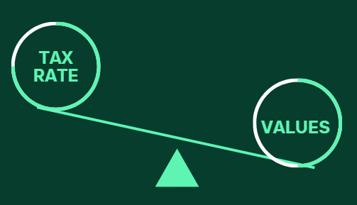
Why is the No-New-Revenue (NNR) Rate Higher Than Our Current Rate?
Adjustments in Taxable Property Value
If the overall taxable value of properties decreases (due to exemptions, protests, or market shifts), the NNR rate must rise to generate the same revenue
City has approximately $336 million of value in litigation or under appeal under Chapter 42 for 2024
Slower Growth Patterns of Current Properties
Percentage Increase History of Certified Values
2020 | 2021 | 2022 | 2023 | 2024 | 2025
8.42% | 11.21% | 15.27% | 10.45% | 10.78% | 6.13%

Slide 8
No New Revenue Rate & Requirements
If the Proposed Tax Rate does not exceed the No New Revenue rate, the following is required:
Publish a Notice of Meeting to Vote on Tax Rate
An increase to the tax rate is not a tax increase unless the proposed tax rate exceeds the NNR rate.
Increase of current tax rate $0.32 to proposed tax rate $0.33 (Not a tax increase)
Proposed Tax Rate $0.33 < NNR Rate $0.334287 (Not a Tax Increase)

Slide 9
Tax Rate & Distribution History

Slide 10
Property Tax Exemptions
The Residential Homestead Exemption remains at the greater of 20% of Value or $5,000 minimum. State maximum allowed is 20%.
Average Residential Homestead Exemption savings - $188 a year
The Over 65 Exemption and the Disabled Persons Exemption are both at $85,000.
Average Over 65 exemption savings - $280 a year
Residential Homestead: 2019 – 1% / 2020 - 10% / 2021 – 15% / 2022 – 20%
Over 65 Local Exemption: 2018 - $45,000 / 2019 - $60,000 / 2020 -$75,000 / 2024 - $85,000
Disabled Persons Exemption: 2018 - $30,000 / 2019 - $45,000 / 2020 – $60,000 / 2021 - $75,000 / 2024 - $85,000

Slide 11
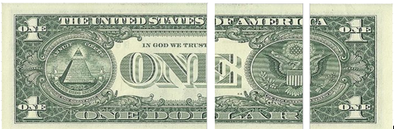
Overlapping Tax Rates (Based on 2024 Tax Rates)
Lamar Consolidated ISD Fort Bend County City of Rosenberg
51%* 28%* 21%*
*after homestead exemption

Slide 12

Rosenberg’s Portion of Average Homestead Tax Bills at $0.33
Average Senior Homestead Household Tax Bill ($240,000 Value)
$353/year
$30/month
Average Homestead
Household Tax Bill ($285,000 Value)
$752/year
$63/month

Slide 13
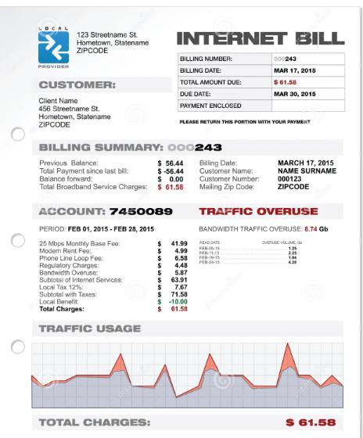
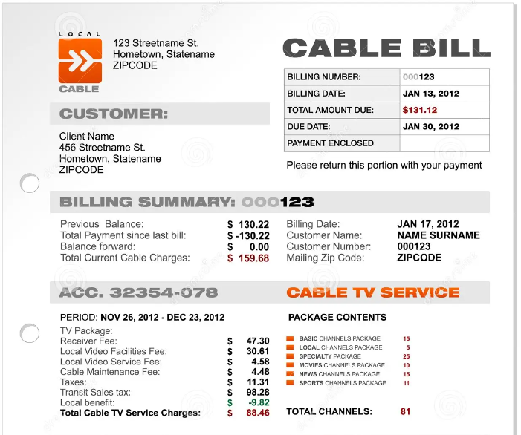
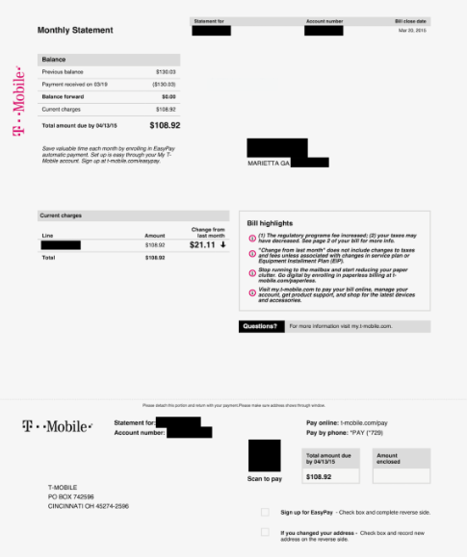
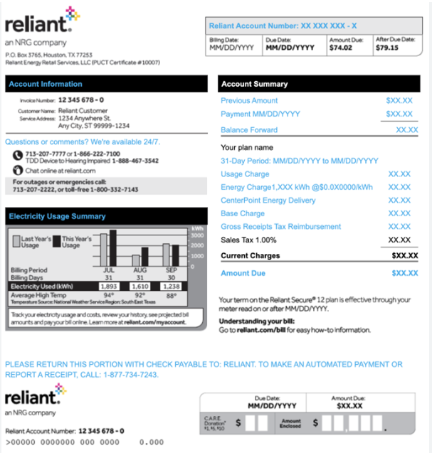
Monthly City Tax Bill vs Other Average Utility Bills
Property Value $285,000 Taxable Value (w/20% homestead exemption) - $228,000 | Total City Tax Bill - $752.40 Monthly City Tax Bill Allocation
General Government | $7.02
Community Development | $2.03
Police & Animal Shelter | $15.68
Fire & Fire Marshal | $7.20
Public Services | $7.43
Street and Sidewalk Improvements | $0.94
Transfers | $0.17
Debt Service | $22.23
Monthly Tax Amount | $62.70
Internet: $75.00
Cable: $100.00
Cell Phone: $100.00
Electricity: $150.00

Slide 14

Recommendation
Staff is seeking City Council’s support for a proposed tax rate of $0.33 for the 2025 tax year.
A tax rate of $0.33 provides for:
A Balanced General Fund budget without using fund balance
Investment in our employees for salaries and benefits
Adding four (4) full-time positions (3 General Fund and 1 Water/Wastewater Fund)
Maintain the state maximum allowable homestead exemption of 20%
Maintain the Over 65 and Disabled Persons with a homestead exemption of $85,000

Slide 15
Other Considerations
A record vote on the proposed tax rate is needed for posting the proper Notice to taxpayers.
A tax rate of $0.33 is not a tax increase since it is less than the No New Revenue Rate (NNR).
Less growth in valuations compared to previous years
City Council should consider holding the budget workshop meetings to discuss and understand the proposed budget prior to making any changes to the tax rate.
A rate lower than the proposed tax rate of $0.33 will require reductions or reallocations to the budget and will make it challenging to add any other items requested by City Council.
1 penny of the tax rate equals $492,000 of expenditures

Slide 16
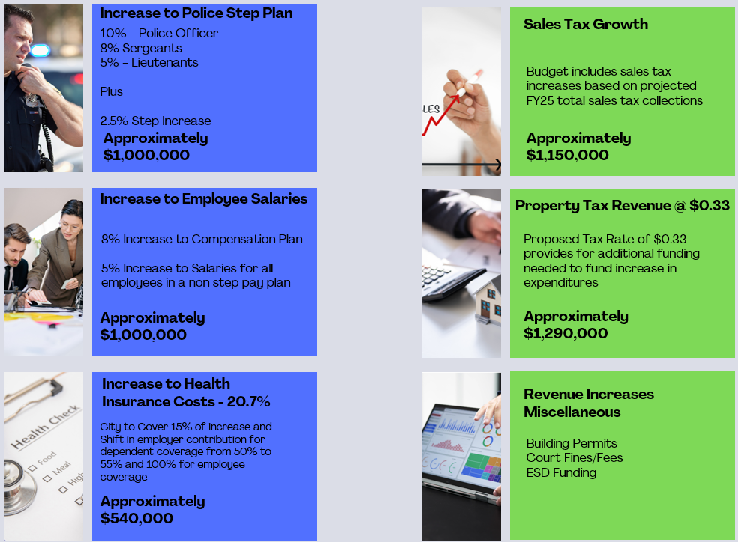
Increase in Revenues to pay for Investment in Employees
Cost Increases to
Investment in Employees

Slide 17
City Council Action on Tax Rate
August 19 & August 26
Notice of Meeting to Vote on Tax Rate
Published and Posted
September 2
Vote to Adopt a Tax Rate for
Fiscal Year 2026
August 5
Record Vote to Establish
Proposed Tax Rate

