Slide 1

Rosenberg Police Department
August 2021 Monthly Report
* The data provided is for informational use only and may differ from official Rosenberg Police crime data. The police department’s crime database is continuously updated, therefore, reports run at different times may produce different results.

Slide 2
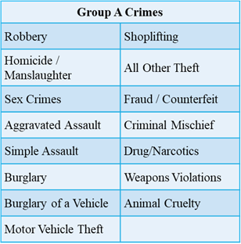

MONTHLY COMPARISON
GROUP A

Slide 3
4 year comparison
GROUP A for the month of August

Slide 4
4 year comparison
Property crimes for the month of August

Slide 5
4 year comparison
Person crimes for the month of August

Slide 6
4 year comparison
Violent crimes for the month of August

Slide 7
Criminal Investigations Division
Assigned Cases
August

Slide 8
Patrol Division
2021 Documented Crashes
Total for 2021 = 641

Slide 9
Commercial vehicle enforcement
August CVE Inspections = 3
Case No. | Violations | Result | Disposition
21-37477 | 10 Violations | 2 Citations | Placed Out Of Service
21-37504 | 8 Violations | 2 Citations | Placed Out Of Service
21-37516 | No Violations

Slide 10
Commercial vehicle enforcement
August Violations
City Ordinance - Prohibited Trucks
Citations = 15 Warnings = 4
Case No. | Date | Result | Location
21-37521 | Aug 11, 2021 | Citation | 3000 Bamore Rd
21-37522 | Aug 11, 2021 | Citation | Bamore Rd / Wilburn St
21-38684 | Aug 18, 2021 | Warning | 1900 Bamore Rd
21-38694 | Aug 18, 2021 | Citation | 500 Walnut Ave
21-38868 | Aug 19, 2021 | Citation | Scott Rd / US 90A W
21-38875 | Aug 19, 2021 | Citation | 2000 Scott Rd
21-39885 | Aug 24, 2021 | Citation | 3000 Bamore Rd
21-39906 | Aug 24, 2021 | Citation | 3000 Bamore Rd
21-40149 | Aug 25, 2021 | Warning | 3200 Bamore Rd
21-40109 | Aug 25, 2021 | Warning | 3000 Bamore Rd
21-40125 | Aug 25, 2021 | Citation | 3000 Bamore Rd
21-40110 | Aug 25, 2021 | Citation | 3000 Bamore Rd
21-40120 | Aug 25, 2021 | Citation | Bamore Rd / Ave L
21-40129 | Aug 25, 2021 | Citation | 3000 Bamore Rd
21-40458 | Aug 26, 2021 | Citation | 3400 Bamore Rd
21-40457 | Aug 26, 2021 | Warning | 3400 Bamore Rd
21-40455 | Aug 26, 2021 | Citation | 3400 Bamore Rd
21-40459 | Aug 26, 2021 | Citation | 3400 Bamore Rd
21-40692 | Aug 27, 2021 | Citation | 3400 Bamore Rd

Slide 11
Commercial vehicle enforcement
Traffic Complaint on Blume Road
Citizen contacted the police department in reference to commercial vehicles speeding on Blume Road.
The traffic division conducted an operation to address the complaint. The traffic division spent approximately 9 hours in this location in the past 2 weeks during the peak times listed in the complaint and did not find any violations regarding speeding commercial vehicles.
A radar trailer was placed on location to assess the speed of all vehicles on the street at all times of day.
  Study conducted from 8/23/21 at 1700hrs to 9/7/21 at 1200hrs
  44,865 vehicles traveled through this location during this time
  547 (1.2% of all vehicles) traveled through this location significantly speeding (>10MPH over limit)
  23 (0.05% of all vehicle) traveled through this location at >20MPH over limit
  *** Study does not differentiate between vehicles and includes any emergency personnel (Police, Fire, EMS) traveling through the location***

Slide 12

Massage Parlor inspections
6 inspections were completed resulting in 5 violations.
Violations:
  Fail to Complete Human Trafficking Course (2 violations)
  Management of Massage Establishment (2 violations)
    Owner/Manger not on location
    List of employees not available
  Accessibility
    Business doors locked during business hours (1 violation)

Slide 13
Communications Division
Total Emergency and Non-Emergency Calls
Law: 5237
Fire: 504
Misc: 92
Law: 5316
Fire: 605
Misc: 83

Slide 14
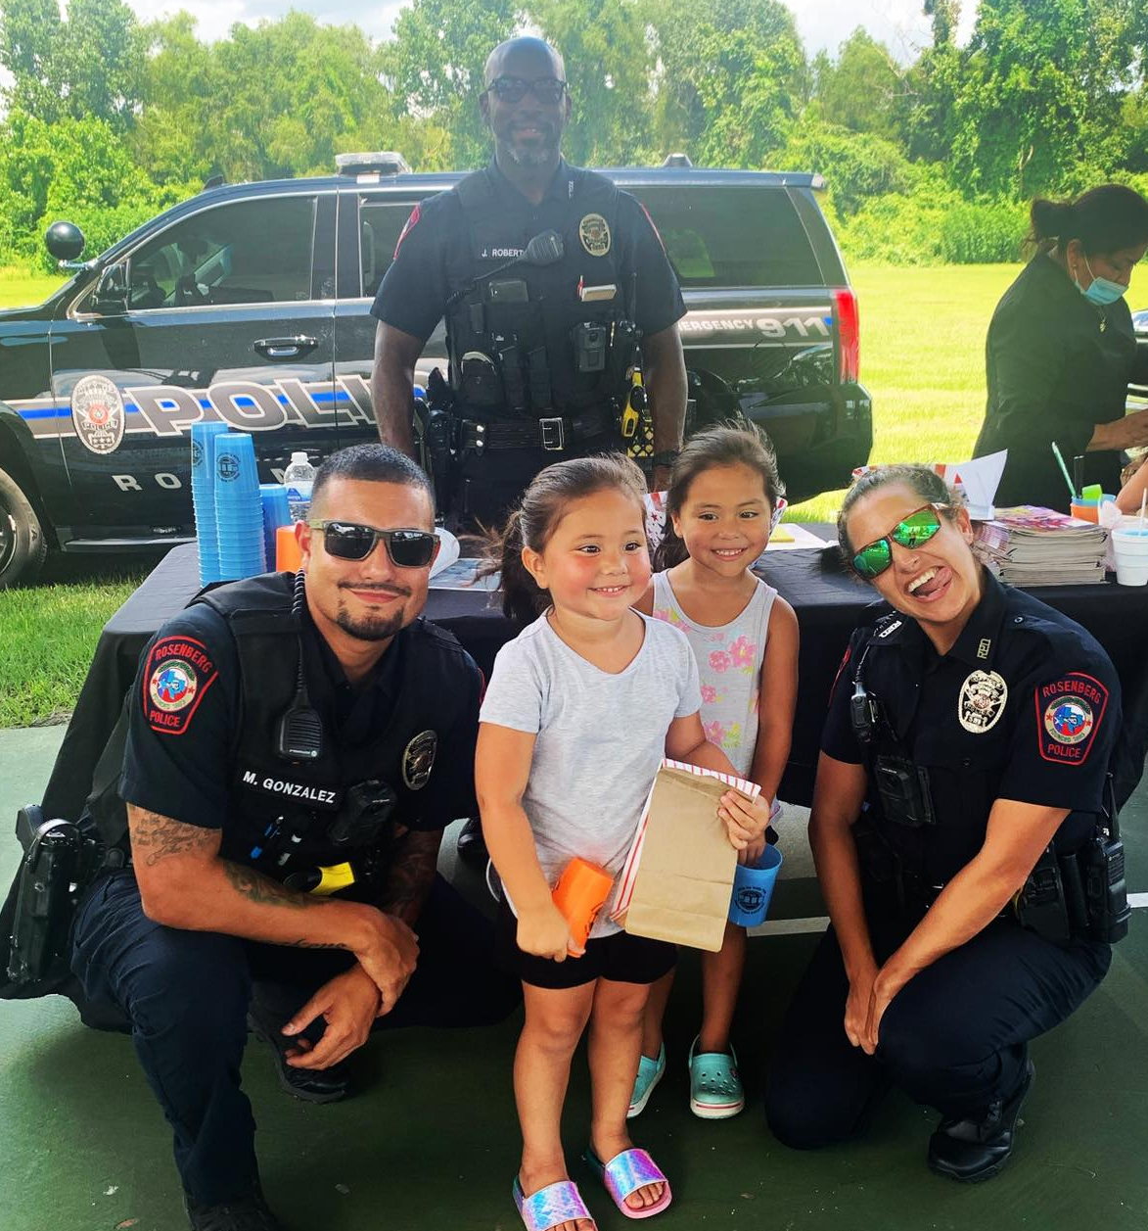
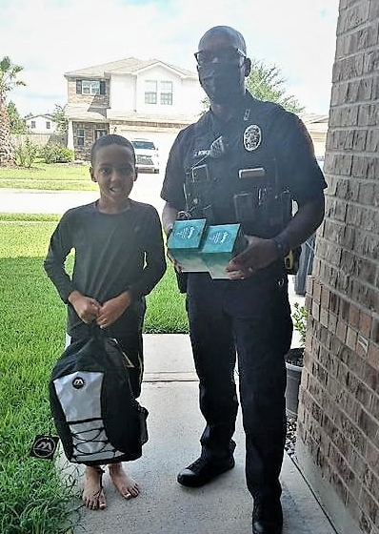
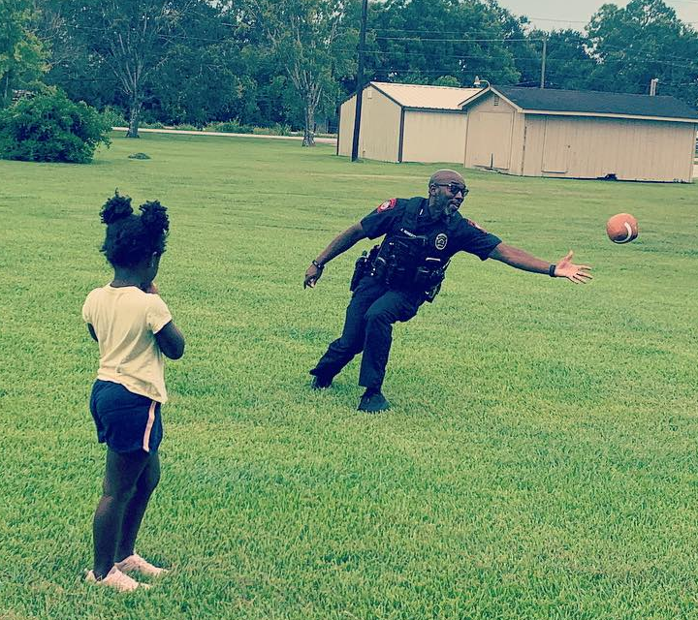

Community Relations Division
Planned for the upcoming National Night Event
Planned for the upcoming Citizen Police Academy
Participated in back to school supply handout event.
Coordinated training for patrol regarding traffic stops involving persons with autism
Coordinated back to school supplies giveaway on behalf of the PD and Rosenberg Police Officers Association

Slide 15

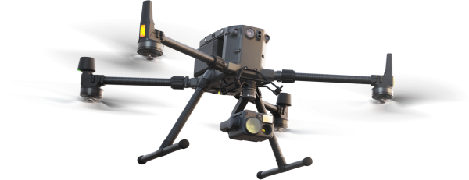
UAV unit
UAV deployed 5 times for month of August
  Assist FBCSO with search for suicidal subject .
      Subject was located
  Searched rooftop and surrounding area for subject in attempted burglary.
  Assisted Richmond PD with a subject firing a gun under the river bridge.
      Suspects were located and detained by Richmond PD.
  Assisted Brazoria Police with search for suspect from high speed pursuit which ended just outside Rosenberg city limits.
      2 RPD Drones deployed
      Used thermal cameras to search for heat signatures in large field and in the extremely thick grassy area
      Subject was located and provided a light source for Officers on the ground
  * See video for view of upgraded thermal camera and the
  aid provided by the UAV to officers on the ground.
UAV deployed 22 times YTD

Slide 16
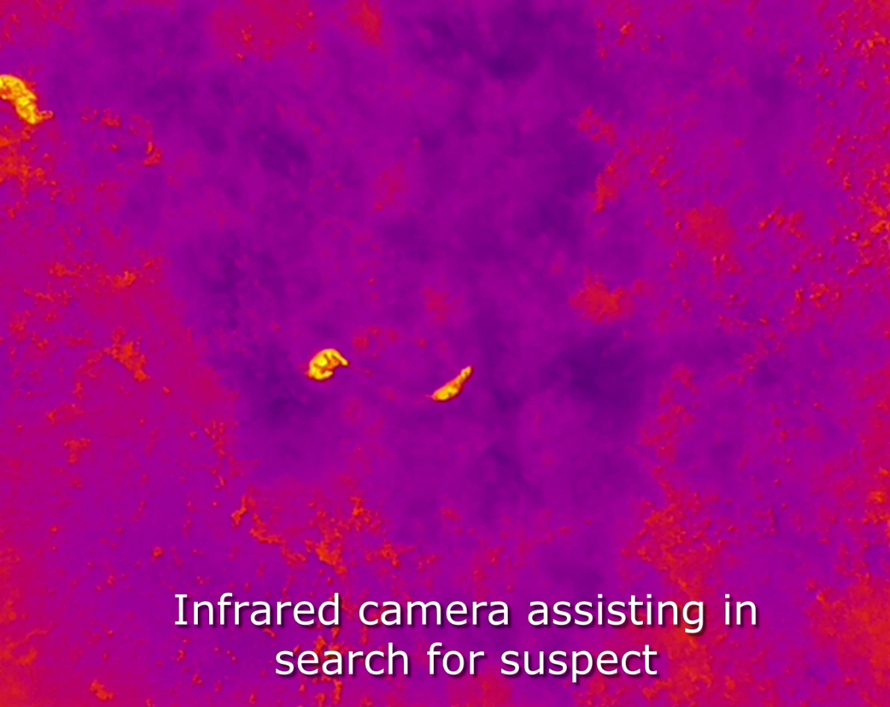

Slide 17
Employees of the week
Week of August 6th – Officer Luke Mathems was selected for solving an overnight commercial burglary and the next night solving several burglary of vehicle cases occurring at CenterPoint.
Week of August 13th – Officer Roberts was selected for the great positive impact he has on our community.
Week of August 20th – Detective Havelka was selected for his willingness to assist Sugar Land PD with a homicide investigation. Detective Havelka has a skillset which greatly helped in processing the crime scene.
Week of August 27 - Detective Freeman was selected for his diligence in apprehending a “serial burglar” by conducting surveillance and obtaining an arrest warrant, ultimately solving 3 burglaries at local businesses.

